Slide 1
Team Delphi -
Progress Update
Anirban Chowdhury, April Wang, Bhoomika Moorjani,
Manna Zhao, Rosa Jin

Slide 2
Data Source and Signals Exploration
Test positivity rate from CTIS and Quidel
Estimated test positivity rate (percent) among people tested for COVID-19 in the past 14 days (CTIS)
Percentage of antigen tests that were positive for COVID-19 (all ages), smoothed by pooling together the last 7 days of tests (Quidel)
COVID symptoms (sore throat) from CTIS and Google search
Estimated % of people reporting that they or someone in their household experienced a sore throat in the past 24 hours (CTIS)
Measures search volume for “sore throat” symptom (Google search)
Notes:
COVID-19 Trends and Impact Survey (CTIS) run by the Delphi group at Carnegie Mellon. Facebook directs a random sample of its users to these surveys, which are voluntary. Users age 18 or older are eligible to complete the surveys, and their survey responses are held by CMU and are sharable with other health researchers under a data use agreement. No individual survey responses are shared back to Facebook.

Slide 3
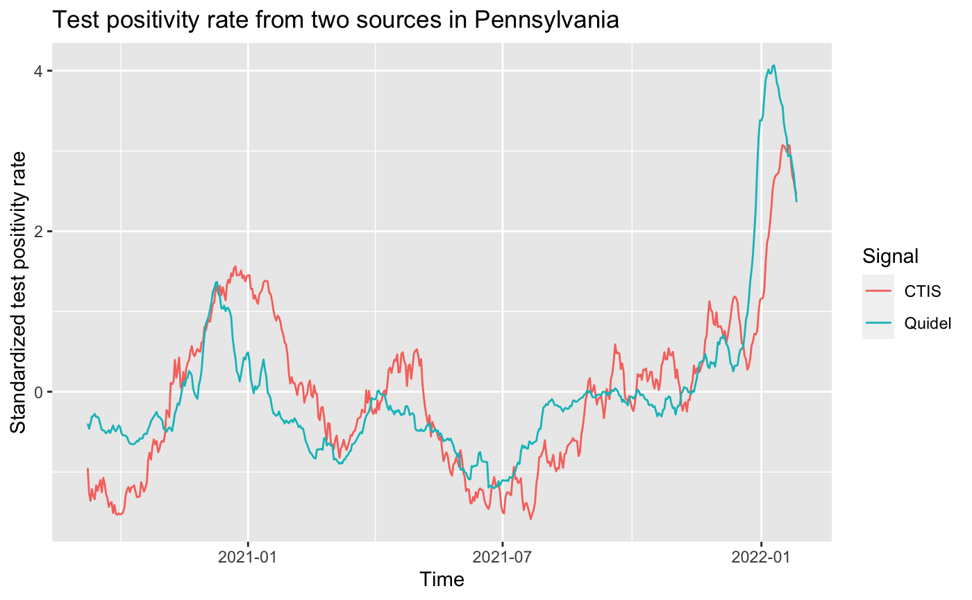
Test Positivity Rate
Rapid Antigen tests (at a doctor’s office, clinic, or hospital)
Spearman’s rank correlation rho estimate: 0.806
Notes:
Data source based on COVID-19 Antigen tests, provided to us by Quidel, Inc. When a patient (whether at a doctor’s office, clinic, or hospital) has COVID-like symptoms, doctors may order an antigen test. An antigen test can detect parts of the virus that are present during an active infection. This is in contrast with antibody tests, which detect parts of the immune system that react to the virus, but which persist long after the infection has passed.

Slide 4
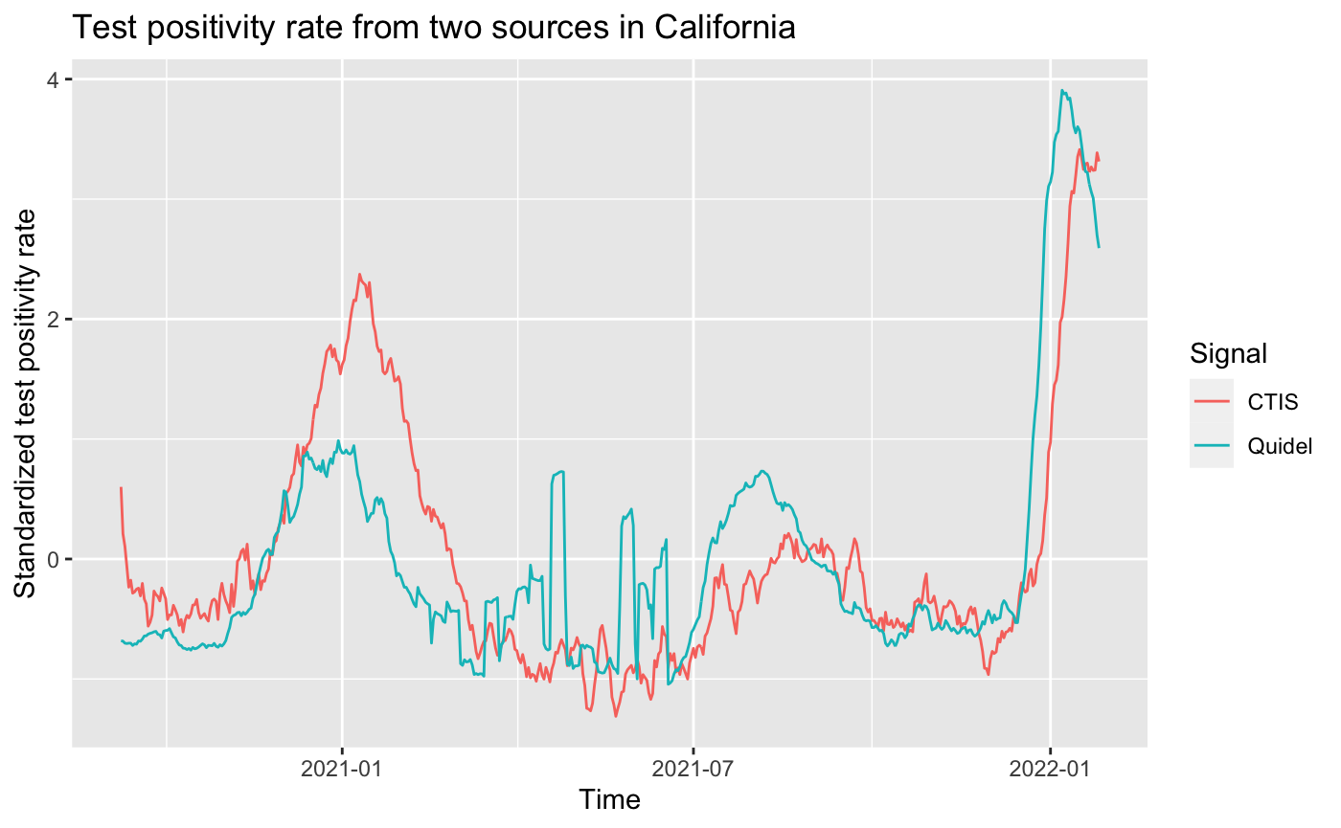
Test Positivity Rate
Spearman’s rank correlation rho estimate: 0.617

Slide 5
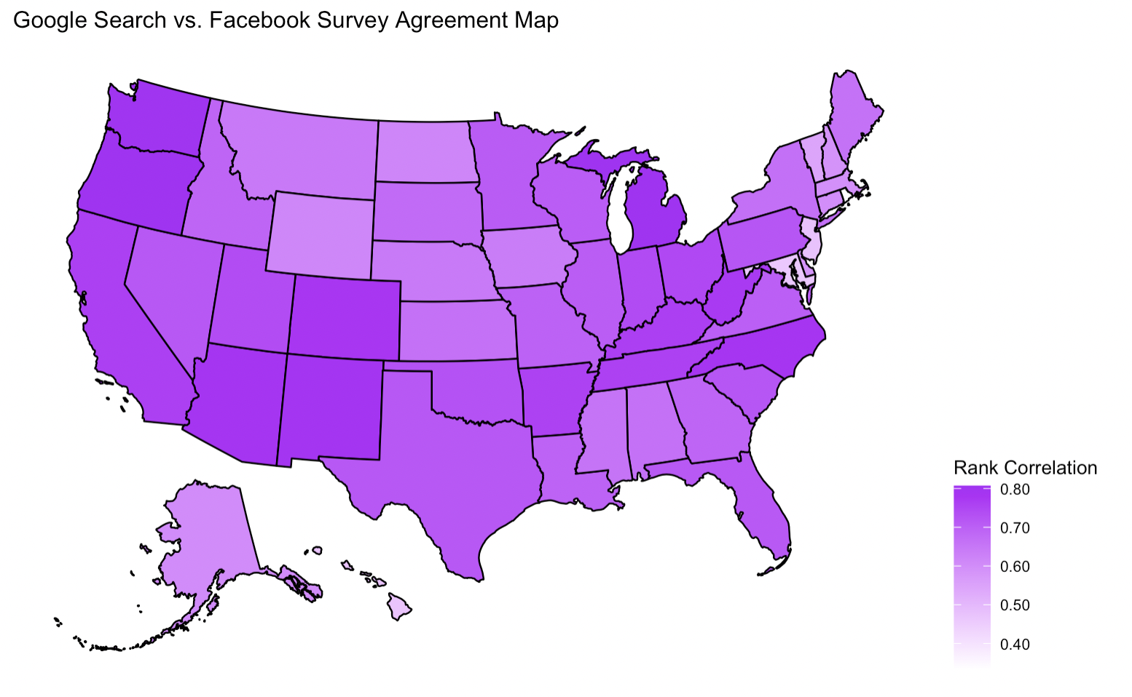
Google Search vs. Facebook Survey Across Country
Less agreement in New England/Midwest
More agreement in West/Central

Slide 6
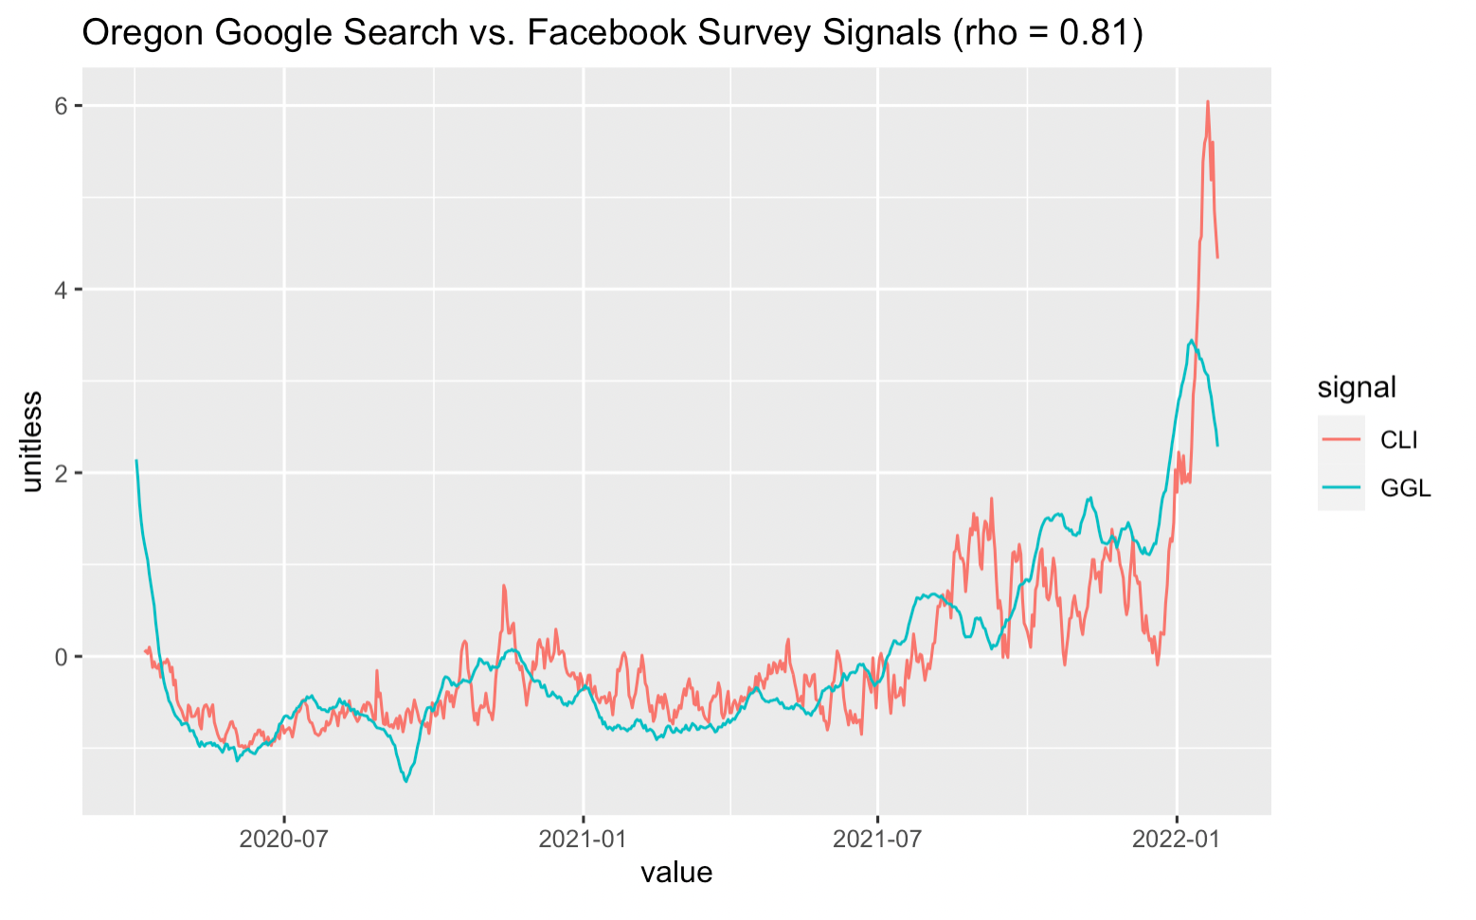
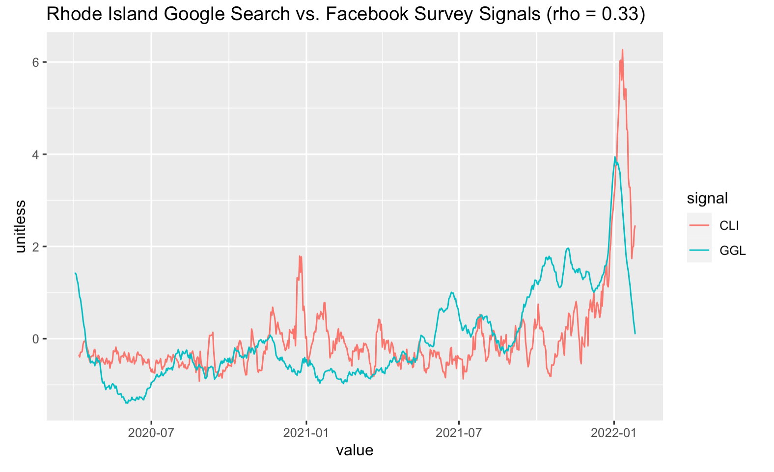
Google Search vs. Facebook Survey Across States
Most Agreement:
Least Agreement:

Slide 7
Possible Reasons for Disagreements:
Policy change: Democratic party has conducted several policy change from 2021 to 2022
Missing data: Much data in Test positivity rate from CTIS and Quidel is missing
Biasness - For small sample sizes, the response might be affected
Future investigation: we should use more approach to evaluate the correlation and similarities

